Slide 1

Computational Models of Cognition
Week 5

Slide 2
Outline
Poverty of Stimulus
Gold’s theorem
Problem of induction
New riddle of induction
Similarity spaces and features

Slide 3
Observe some values of a function

Slide 4
Guess the whole function

Slide 5
Another guess: Just as good?

Slide 6
More data needed to decide

Slide 7
Poverty of the Stimulus (1957)
Chomsky: Just like polynomials: never enough data unless you know something in advance. So kids must be born knowing what to expect in language.
Children listen to language
Children are corrected??
Children observe language in context
Children observe frequencies of language

Slide 8
Plato’s Problem
General problem:
How are humans, whose experiences in the world are brief, personal, and limited, able to know as much as they do?
Language version:
How are children able to learn the principles of a language given their limited experience?
Notes:
Even Plato had identified this

Slide 9
Poverty of the Stimulus
Open Questions:
Is the premise valid?
What is meant by innate?
What constitutes learning?

Slide 10
Gold’s Theorem (1967)
a simple negative result along these lines: kids (or computers) can’t learn much
without supervision, inborn knowledge, or statistics
Children listen to language
Children are corrected??
Children observe language in context
Children observe frequencies of language

Slide 11

Language Identiﬁcation in the Limit A drama in 3 acts
with apologies to E. M. Gold
The teacher
The learner

Slide 12
Prologue
Gold’s Theorem: A mathematical result about the learnability of formal language classes.
Formal Definitions
Language := the set of all the valid sentences of a language
Language Class := a set containing multiple languages
Learning := language identification in the limit. a point at which a learner’s hypothesis is correct and never changes

Slide 13
Act 1: Exposition
Teacher outputs a sentence
Learner attempts to guess what the teacher’s language is given the sentences they’ve seen so far
Repeat
Assumption
The teacher’s alphabet is finite.
Guarantees
The teacher’s language is in the set of hypotheses that the learner is considering
Any sentence in the teacher’s language is eventually uttered by the teacher (even if there are infinitely many!)
Notes:
A learner is any function which maps a ﬁnite set of observed sentences to a target language
Given a collection of languages, C, a learner learns C IFF she can distinguish every language in C

Slide 14
Set of potential languages:
4
2
7
8
6
L₇
L₄
L₈
3
…
(Teacher’s language = L₈)
Notes:
We note that each language L_{n} in this class is a proper subset of language L_{n+1}

Slide 15
Act 1: Exposition
Extrapolating from our example, we can show that any language class consisting solely of finite languages* will be identifiable in the limit
e.g., is learnable for all finite n
* languages consisting of a finite number of sentences

Slide 16
Act 2: Crisis
Introducing infinity
Define a new language class:
Where contains every sentence in for all finite n.

Slide 17
Set of potential languages:
50
2
754
1800
…
L₅₀
L₇₅₄
L₁₈₀₀
…
Notes:
We note that each language L_{n} in this class is a proper subset of language L_{n+1}

Slide 18
Act 2: Crisis
Remember our definition of learning
Learning := language identification in the limit. a point at which a learner’s hypothesis is correct and never changes

Slide 19
Act 2: Crisis
Does there exist a learner that is able to correctly distinguish between the languages in the class
in the limit?
If yes, what should their strategy be?
If no, why not?
Notes:
The answer is no

Slide 20
Act 3: Resolution
Gold’s Theorem:
Provided with just a text, any set of languages which contains all finite languages and at least one infinite language is not identifiable in the limit.
Why?

Slide 21
Gold’s Theorem: Proof Sketch
Claim: Our teacher can prevent any learner from correctly converging to L∞ in the limit.
Proof: If the learner at any point guesses L∞, the teacher should generate sentences from a finite language L_{n} that is still consistent with the sentences seen so far.
If the learner is perfect, they must eventually change their guess to L_{n}
But now the teacher resumes generating from L∞. The learner will eventually have to change their answer again. Now we repeat.
Conclusion: There is no perfect learner that is guaranteed to converge to L₀, L₁, … or L∞ as appropriate. If they always succeed on finite languages, the teacher can trick them on an infinite language

Slide 22
So how do we learn language?
Chomsky Hierarchy
Computable
Context sensitive
(Natural Languages)
Context free
Regular
Finite
Notes:
Recall that the languages in the Chomsky hierarchy are nested – that is, each superordinate level contains the levels below it as a special case.

Slide 23
Poverty of the Stimulus and Universal Grammar
Chomsky: Language learning requires strong, domain specific constraints on the set of possible languages considered by a learner
Universal Grammar: The rules which define the grammars in this set

Slide 24
Open Questions
Are languages best characterized as sets of sentences?
Are texts generated adversarially?
Do learners only see positive examples of a text?
What constitutes learning?

Slide 25
Summary: Gold’s Theorem
What it says
Under Gold’s definition of a learner’s environment, the set of hypotheses they select from, and their criterion for learning, it can be shown that certain classes of languages are unlearnable.
What it does not say
Specific languages are in principle unlearnable
Different types of learners might fare better when playing Gold’s game
Universal Grammar must be true
Notes:
Gold’s theorem arises from the relationship between languages in a class rather than the complexity within particular languages
Gold’s result applies to all learners (so long as they meet the definition in the problem statement).

Slide 26
Questions?

Slide 27
Problem of induction
The past cannot tell us about the future
We can’t justify the principle using argument

Slide 28
New riddle of induction
P1: Induction only works when the predicates form lawlike generalizations
P2: We cannot tell which predicates will form lawlike generalizations
P3: We cannot tell when induction works and when it does not

Slide 29
Predictable predicates
Lawlike:
This ball is round
All balls will be round
Non-lawlike
The last three men who have walked onto this bus have glasses
All men who walk onto this bus will have glasses

Slide 30

Goodman’s riddle

Slide 31
Modeling Similarity Judgments
Spaces Approach
Roger Shepard
Similarity ratings -> Multidimensional Scaling -> Similarity space -> Shepard’s Universal Law
Sets Approach
Amos Tversky
Features - > Contrast Model -> Similarity Ratings

Slide 32
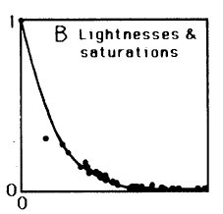
Shepard’s Similarity Spaces
Nonmetric MDS
Shepard’s “Universal” Law
Roger Shepard
Notes:
probability of generalization will fall off exponentially with the distance measured by one of two particular metrics

Slide 33
Models of Similarity
Shepard and Tversky proposed alternate models for predicting psychological similarity
Shepard used the notion of a similarity space where the distance between points corresponded to psychological similarity ratings
Tversky’s approach used functions on sets of features to compute similarity ratings

Slide 34
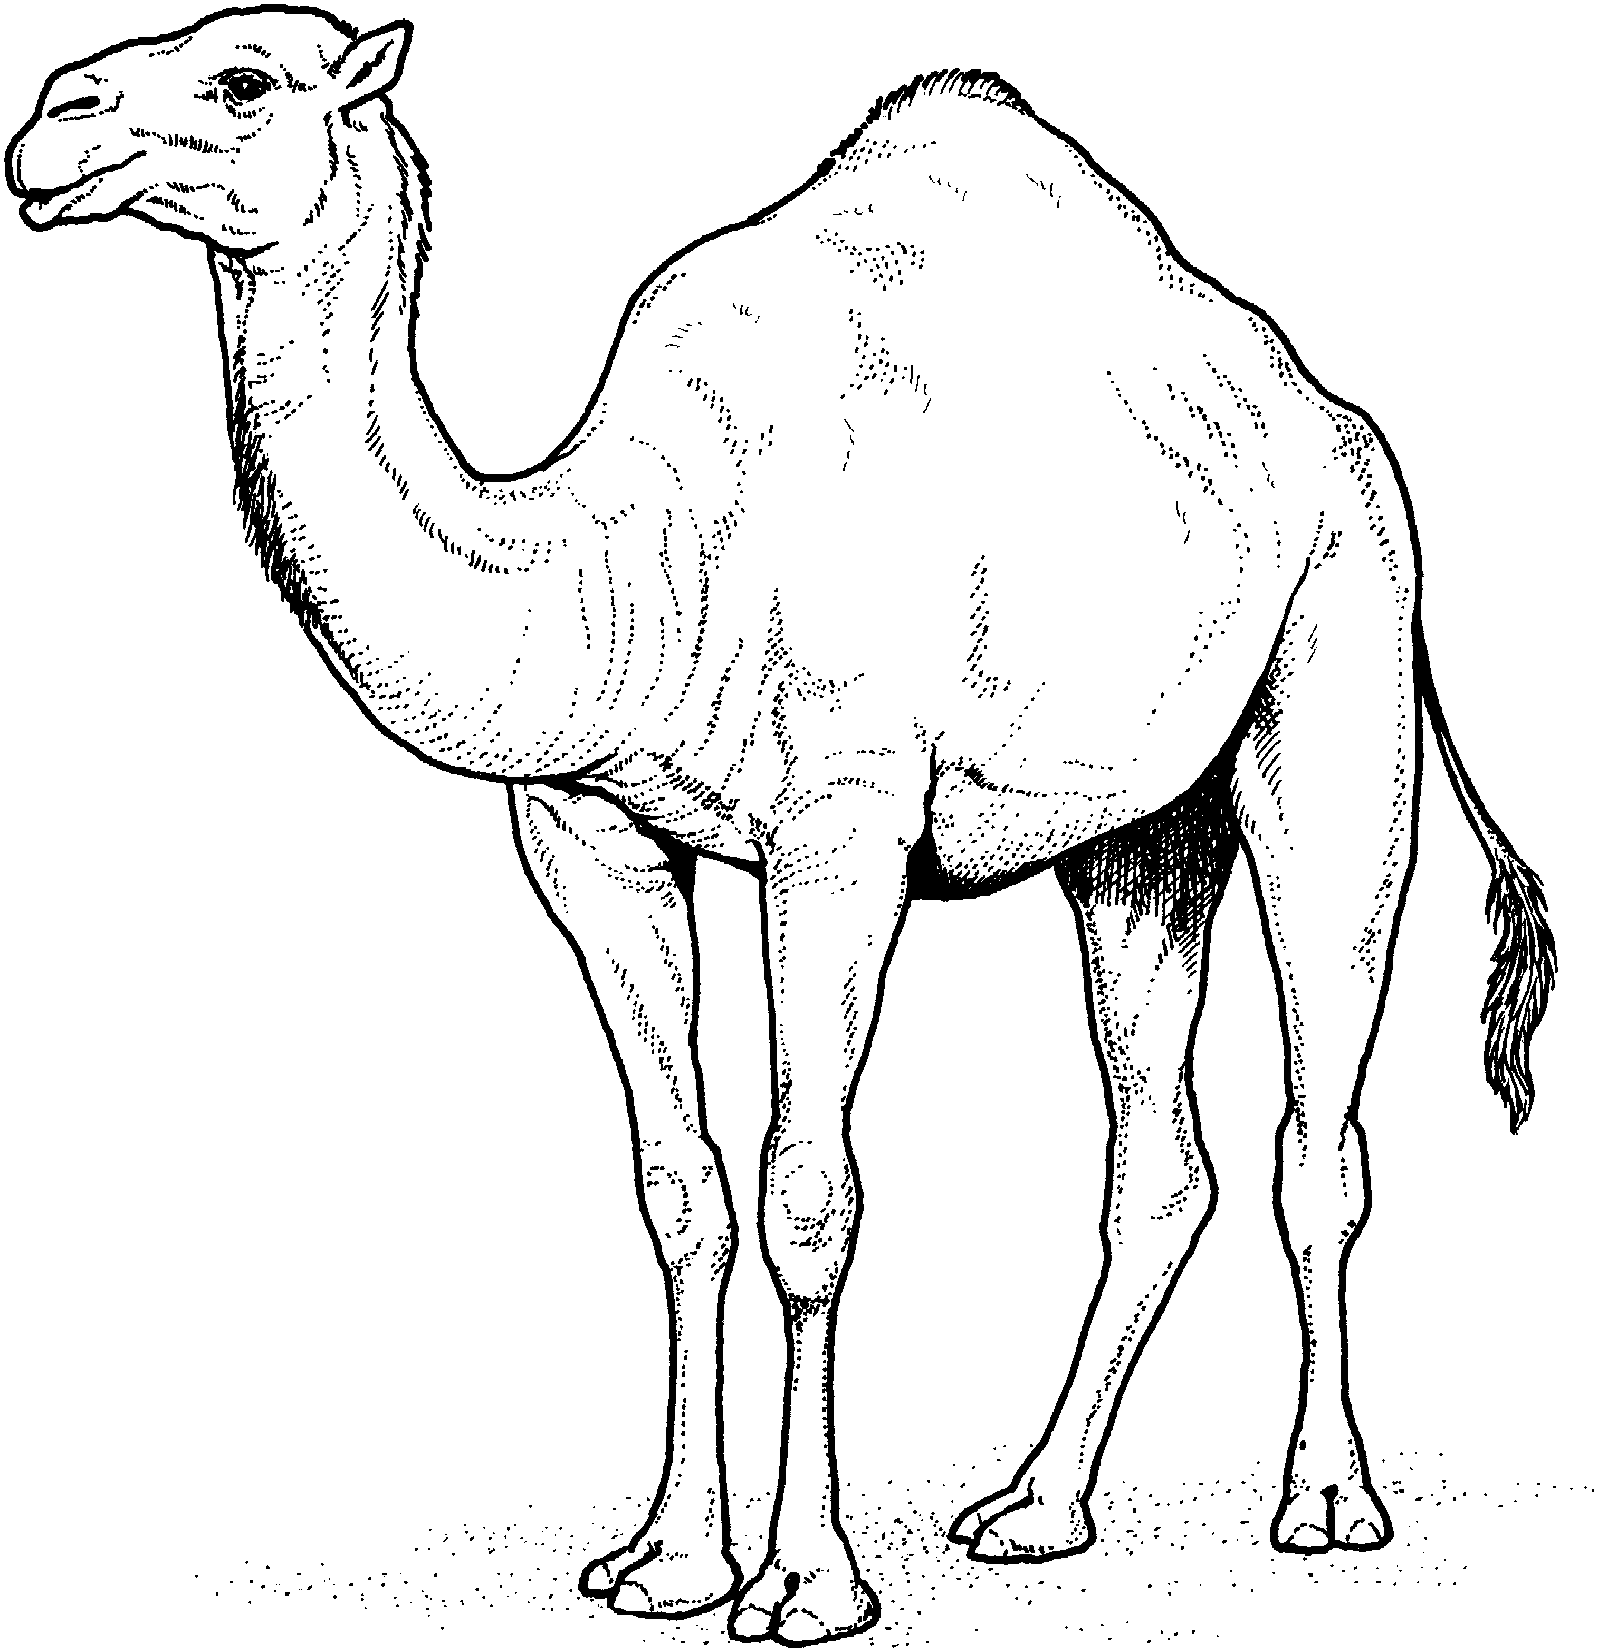
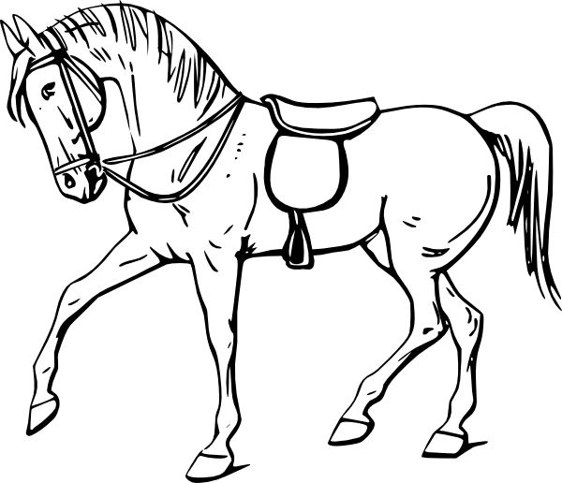

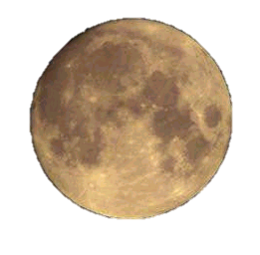

Similarity Spaces: Tversky’s Critique
Similarity judgments appear to violate certain principles of metric spaces
Similarities are often asymmetric
The triangle inequality* does not always hold
Realistic similarity neighborhoods cannot be reproduced in low-dimensional spaces
>
* d(a,c) ≤ d(a,b) + d(b,c)
Notes:
A camel is more similar to a horse than a horse is to a camel
Lightbulb is similar to the moon, moon is similar to a soccer ball, but a lightbulb is not similar to a soccer ball

Slide 35
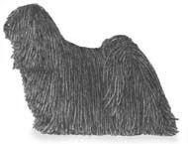
Tversky’s Contrast Model
A
B
Cat Dog
A: set of features for the cat
B: set of features for the dog
f: function from sets to numbers (typically additive)
θ, α, β : free parameters, all ≥ 0
A − B
A ∩ B
B − A
Notes:
Similarity increases with the measure of the common features and decreases with the measure of distinctive features

Slide 36
Next Week
I will be available to answer questions about Problem Set 2.

